Slide 1

Update of “A Policy on Geometric
Design of Highways and Streets”
(AASHTO Green Book)
September 5, 2018
Jeff Jones, P.E., AASHTO Technical Committee on Geometric Design

Slide 2
Topics to Cover
  AASHTO Technical Committee on Geometric Design
  Green Book, 7th Edition (GB7) Significant Changes
  GB7 Availability
  Geometric Design of Low Volume Roads (LVR)
  GB8 Vision (as time permits)

Slide 3
AASHTO Technical Committee on
Geometric Design (TCGD)
Region 1
AASHTO Members
Region 3
Region 4
Associate Members
NACE
National League of Cities
APWA
Port Authority of NY, NJ
Region 2

Slide 4
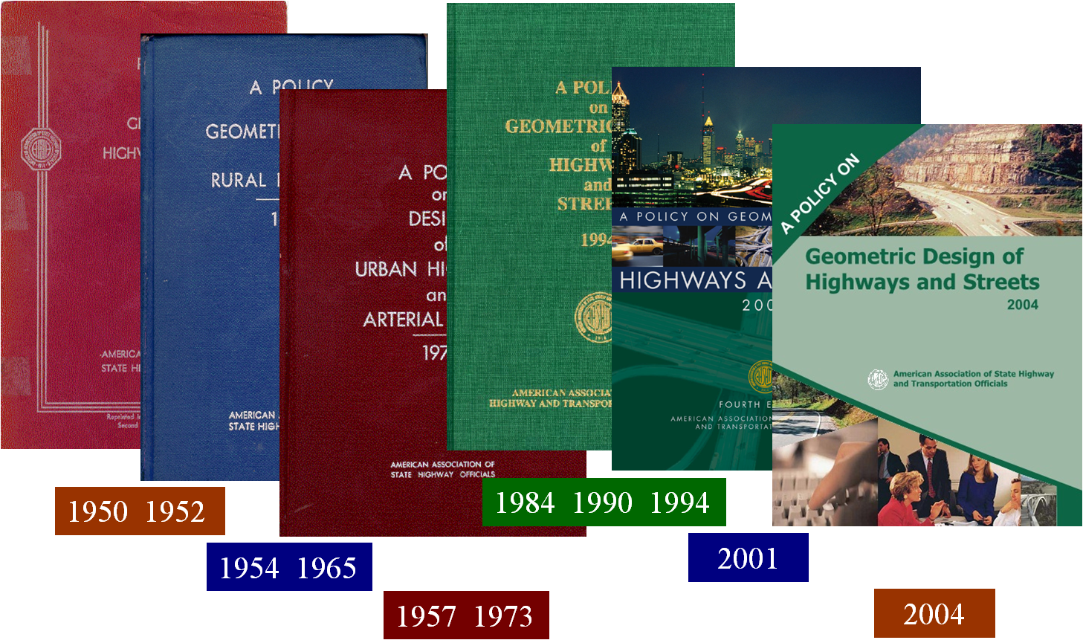
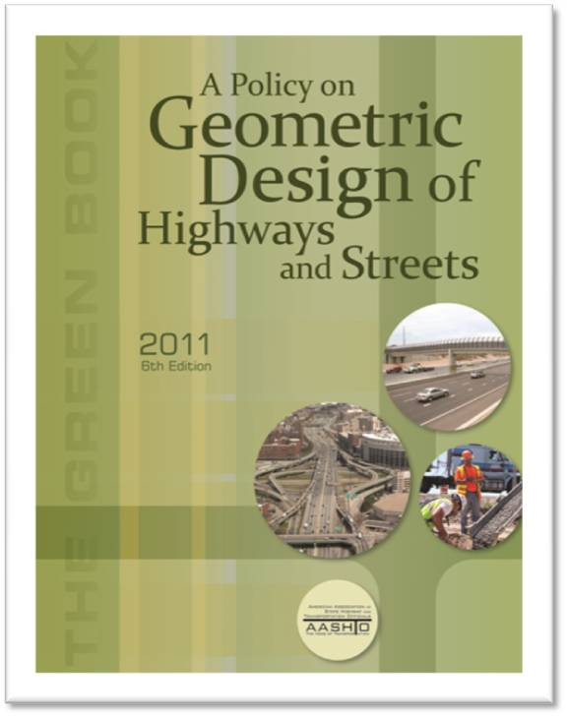
AASHTO Geometric Design Policies
2011
2004
Six Previous Editions of the Green Book

Slide 5
Green Book, 7th Edition Update Cycle
July 2016 | First Working Draft Complete | Woods Hole, MA
March 2017 | Second Working Draft Complete | Washington, DC

Slide 6
Green Book, 7th Edition Update Cycle
July 2016 | First Working Draft Complete | Woods Hole, MA
March 2017 | Second Working Draft Complete | Washington, DC
Summer 2017 | Distributed for review to SCOD Members and all SCOD Technical Committees | Over 700 comments received

Slide 7
Green Book, 7th Edition Update Cycle
July 2016 | First Working Draft Complete | Woods Hole, MA
March 2017 | Second Working Draft Complete | Washington, DC
Summer 2017 | Distributed for review to SCOD Members and all SCOD Technical Committees | Over 700 comments received
Fall 2017 | Ballot Passed Technical Committee on Geometric Design
January 2018 | Ballot Passed Subcommittee on Design
March 2018 | Ballot Passed Council on Highways and Streets and Board of Directors | CHS: 38-2

Slide 8
Green Book, 7th Edition Update Cycle
July 2016 | First Working Draft Complete | Woods Hole, MA
March 2017 | Second Working Draft Complete | Washington, DC
Summer 2017 | Distributed for review to SCOD Members and all SCOD Technical Committees | Over 700 comments received
Fall 2017 | Ballot Passed Technical Committee on Geometric Design
January 2018 | Ballot Passed Subcommittee on Design
March 2018 | Ballot Passed Council on Highways and Streets and Board of Directors
April 2018 | GB7 transmitted to AASHTO Publications

Slide 9
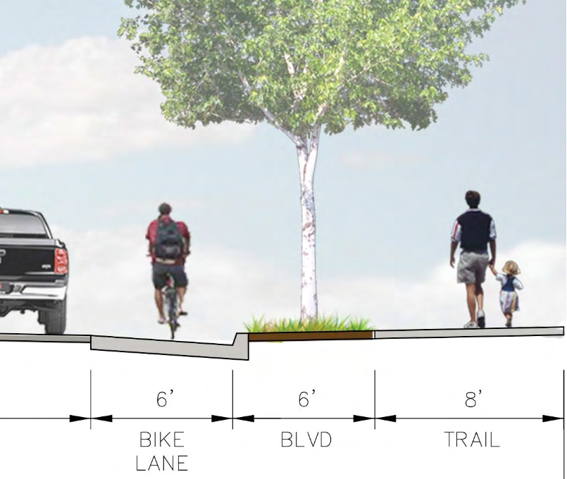
General Changes
Flipped the units (US Customary; metric)
Generally increased the design speed range
          80 mph [130 km/h] in some situations,
          85 mph [140 km/h] in others
Increased emphasis on multimodal
New Context Classifications
ADA / Section 504 requirements

Slide 10
Green Book, 7th Edition
Foreword Preface
Chapter 1: Highway Functions
Chapter 2: Design Controls and Criteria
Chapter 3: Elements of Design
Chapter 4: Cross Section Elements
Chapter 5: Local Roads and Streets
Chapter 6: Collector Roads and Streets
Chapter 7: Arterials
Chapter 8: Freeways
Chapter 9: Intersections
Chapter 10: Grade Separations and Interchanges

Slide 11
Preface
Rewritten... reorganized ( Read )
GB4 - GB6: For Resurfacing (3R)
  Use TRB Special Report 214
GB7: For Resurfacing (3R)
  Use NCHRP Report 876 “Guidelines for Integrating Safety and Cost-Effectiveness into Resurfacing, Restoration, and Rehabilitation (3R) Projects”

Slide 12
Green Book, 7th Edition
Preface
Chapter 1: Highway Functions New Framework for Geometric Design
Chapter 2: Design Controls and Criteria
Chapter 3: Elements of Design
Chapter 4: Cross Section Elements
Chapter 5: Local Roads and Streets
Chapter 6: Collector Roads and Streets
Chapter 7: Arterials
Chapter 8: Freeways
Chapter 9: Intersections
Chapter 10: Grade Separations and Interchanges

Slide 13
Chapter 1 - New Framework for Geometric Design
Chapter Rewrite
NCHRP Report 855: An Expanded Functional Classification System for Highways and Street
NCHRP Report 785: Performance Based Analysis of Geometric Design of Highways and Streets
NCHRP Report 839: A Performance-based Highway Geometric Design Process

Slide 14
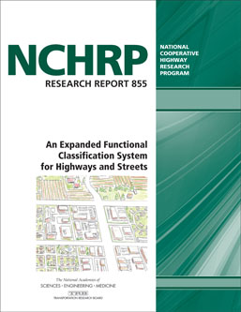
Chapter 1 - New Context Classifications
(based on NCHRP 855)
Two Rural:
Rural and Rural Town
Three Urban:
Urban, Urban Core and Suburban

Slide 15

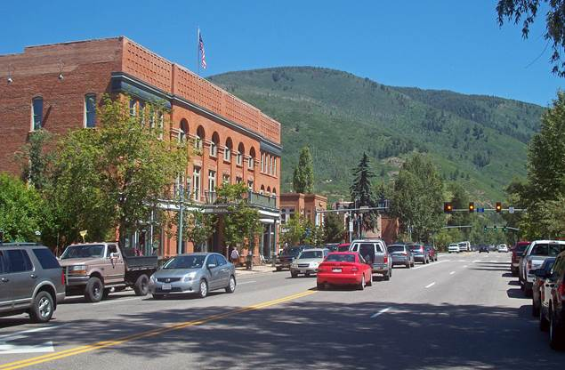
“Rural” Context Classes
Rural Context
Rural Town Context

Slide 16
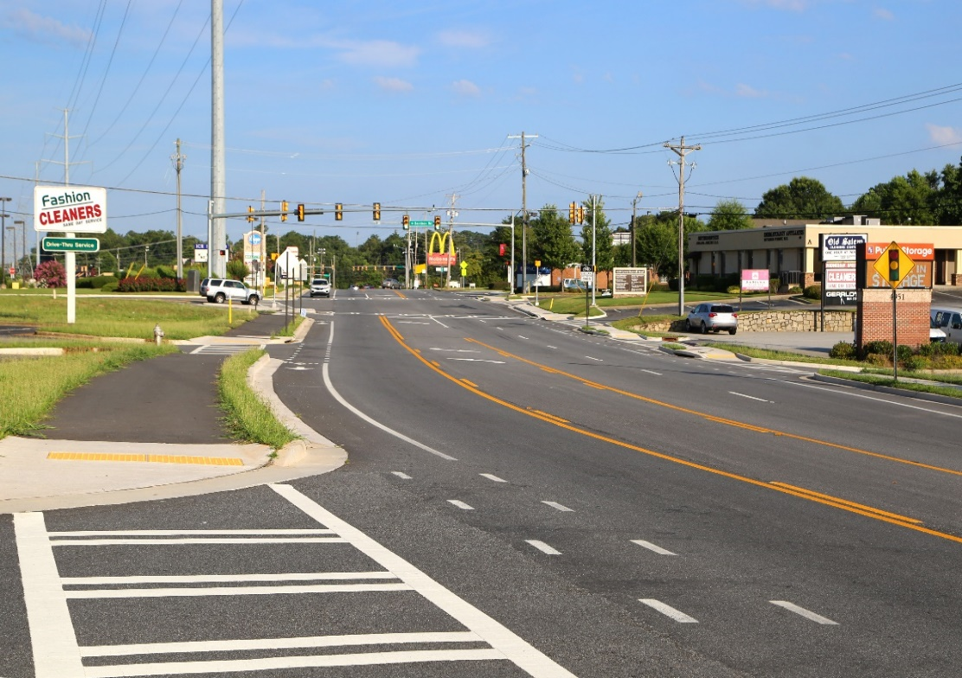
“Suburban” Context Class
Suburban Context

Slide 17
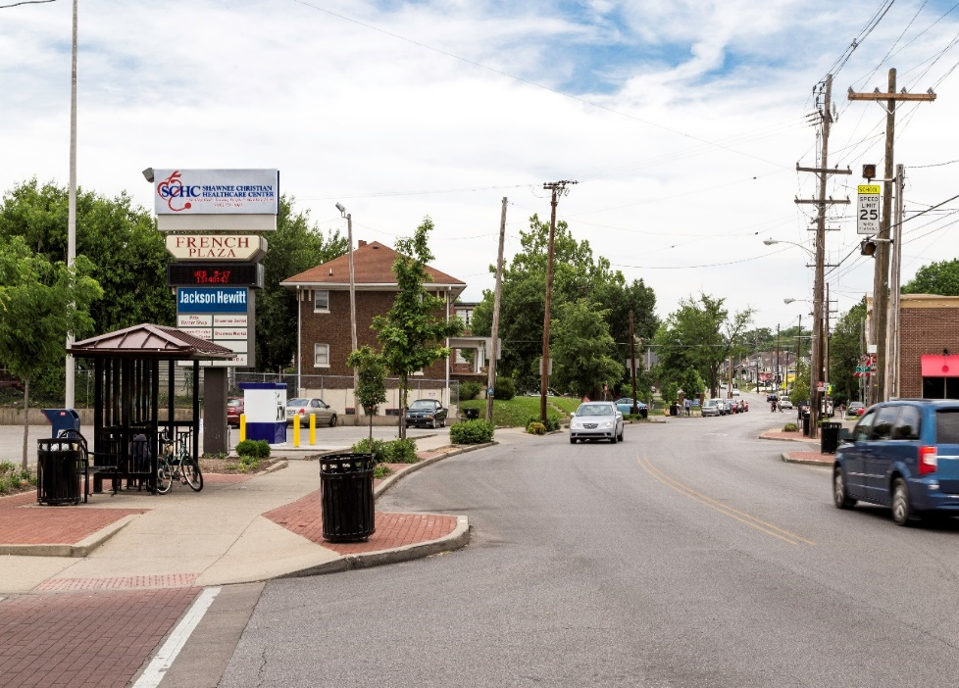
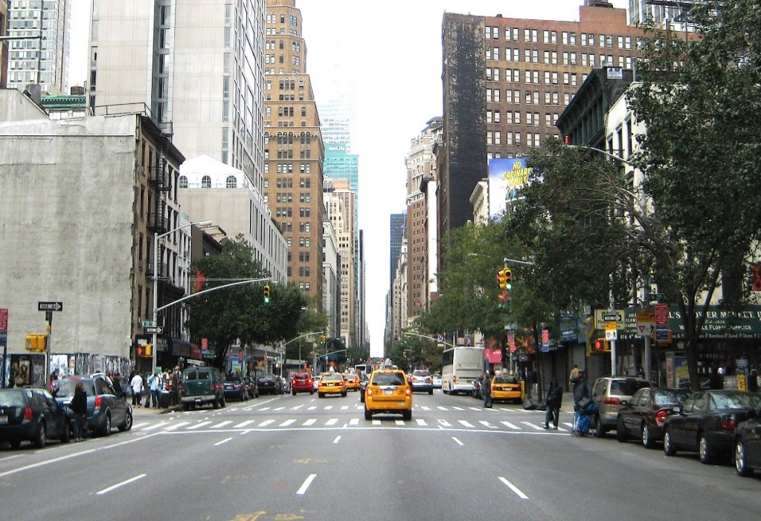
“Urban” Context Classes
Urban Context
Urban Core Context

Slide 18
NCHRP Report 855 - An Expanded Functional Classification System for Highways and Street
Functional Class | Context Class
 | Rural | Rural Town | Suburban | Urban | Urban Core
Local Road or Street
Collector Road or Street
Arterial Road or Street
Freeway

Slide 19
Chapter 1, Section 1.6.1 - “Pedestrians”
ADA / Section 504 Guidance (28 CFR §35.151)
“The ADA requires that a public entity's newly constructed facilities must be made accessible to and usable by individuals with disabilities to the extent that it is not structurally impracticable to do so.”
“The ADA also requires that, when an existing facility is altered, the altered facility must be made accessible to and usable by individuals with disabilities to the maximum extent feasible.”

Slide 20
1.7 Design Process for Project Types
1.7.1 NEW CONSTRUCTION PROJECTS
Chapters 2 through 10 is primarily intended for new construction projects
1.7.2 RECONSTRUCTION PROJECTS
Design guidance in Chapters 2 through 10 is desirable, but may be impractical due to project constraints and may not be relevant to project purpose and need
1.7.3 PROJECTS ON EXISTING ROADS
Projects on existing roads are classified by the primary reason the project is being undertaken (project purpose and need)

Slide 21
Chapter 1 - New Framework for Geometric Design
Performance Measures
Motor Vehicle Speed / Mobility ( GB1 - GB6 )
    20 year traffic projection
    v/c ratio or LOS Goal

Slide 22
Chapter 1 - Projects on Existing Roads
Based on Project Purpose and Need
Purpose / Need | Potential Performance Measure
Mobility / Speed | v/c ratio, delay, LOS
Safety Performance | Crash rate
Surface Condition | IRI / Roughness
Freight Movement | Travel Time Reliability
Economic Development | Job Creation
Bike, Ped and Transit | LOS

Slide 23

Chapter 2 - Design Controls and Criteria
Emphasizes transportation of / for people
    (as opposed to exclusively vehicles)
  Multimodal LOS
  Greater emphasis on lower-speed, walkable, urban zones
Update to pedestrian walking speed
  Was 2.5 – 6.0 ft/s (Now 3.0 – 3.5 ft/s)
Emphasizes the Highway Safety Manual and encourages its use

Slide 24

Chapter 3 - Elements of Design
Added 85 mph [140 km/h] to SSD tables
Explanation of how to compute e and minimum R for design speeds greater than 80 mph [130 km/h]

Slide 25
Chapter 3 - Elements of Design
Superelevation transitions
  More flexibility with distribution and rate of rotation
  Increased awareness of oversupply through transition

Slide 26
Chapter 3 - Elements of Design
NCHRP Report 774
  Finding of potential safety problem with ‘e’ oversupply
  Introduced an equation to check for that condition
    (if criteria not met, reduce Se prior to PC or use spiral)

Slide 27
Chapter 4 - Cross Section Elements
Design of Driveways
(NCHRP 659)
  Expanded discussion of driveway width guidelines
Updated noise abatement discussion per latest FHWA direction

Slide 28


Chapter 5 - Local Roads and Streets
New section on driveways in rural areas
Recreational roads and special purpose roads reorganized into separate sections
Updated minimum curve radii for unpaved roads
  Based on U.S. Forest Service Guidance

Slide 29
Chapters 5, 6 and 7
Revised urban street lane width discussion in Chapters 5 & 6 to align with that in Chapter 7 – i.e. right sizing
Revised rural traveled way and shoulder widths to more right-sized values
  Based on Highway Safety Manual data
Added material presenting design speed ranges for specific contexts

Slide 30

Chapters 5, 6 and 7
Deleted section on bridges to remain in place
(It’s no longer addressed in AASHTO bridge specifications)

Slide 31

Chapters 6 and 7
Added a section based on
NCHRP Report 737
high to low speed
transition zones

Slide 32
Chapter 7 - Arterial Roads and Streets
Title changed from “Rural and Urban Arterials” to “Arterial Roads and Streets”
  Consistency with Chapters 5 and 6
  Reduces potential confusion created by new context categories
New section and other new material on design in the rural town context

Slide 33
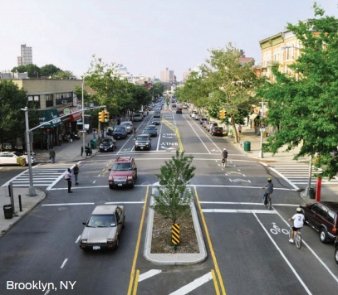
Chapter 7 - Arterial Roads and Streets
Urban Area Design
  Removed material on operational and control measures
    Did not pertain to geometric design
  Added a section on speed management in design

Slide 34
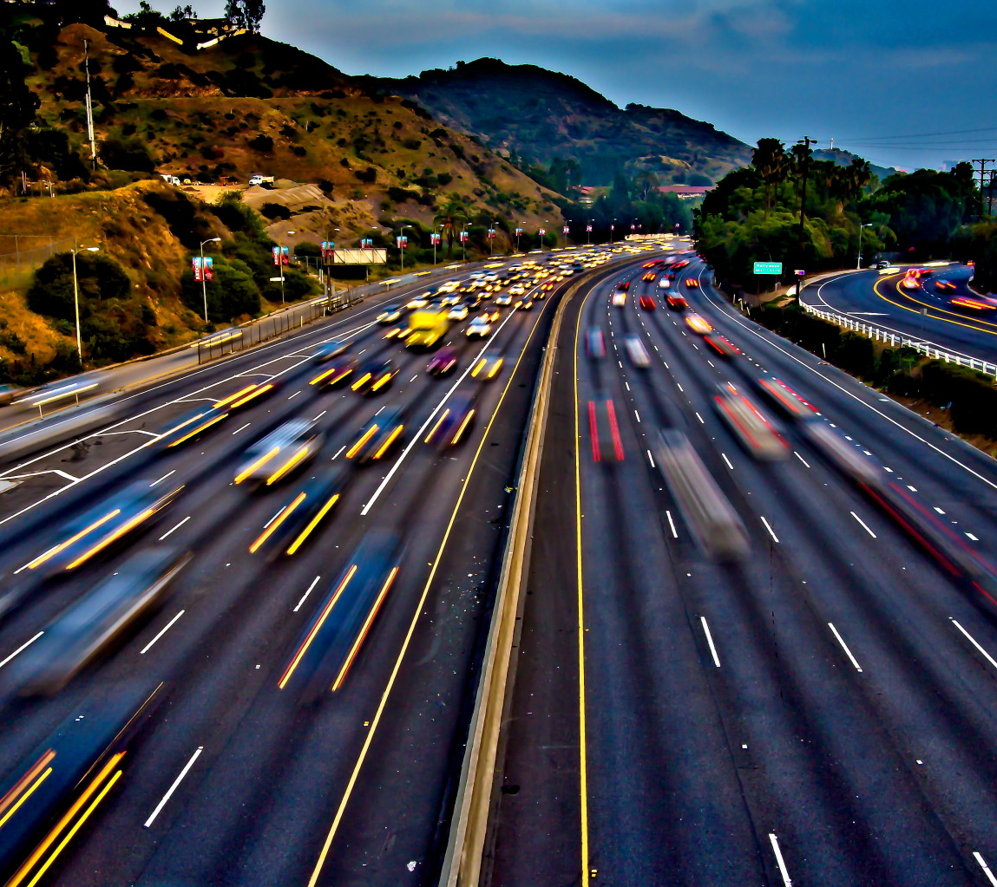
Chapter 8 - Freeways
Revised design speed guidance to encourage right sized and context sensitive designs in urban and suburban settings
  Away from ‘the higher the better’
Removed material targeting specific levels of service

Slide 35
Chapter 9 - Intersections
New or revised drawings and/or text for…
  Channelized right-turn lanes
  Offset left-turn lanes
  Bypass lanes
  Reduced-conflict intersections
    U-turn roadways
    Loons

Slide 36
Chapter 9 - Intersections
Added table on characteristics of non-motorized users
Intersection sight distance discussion for roundabouts
Revised criteria for turn lane length

Slide 37
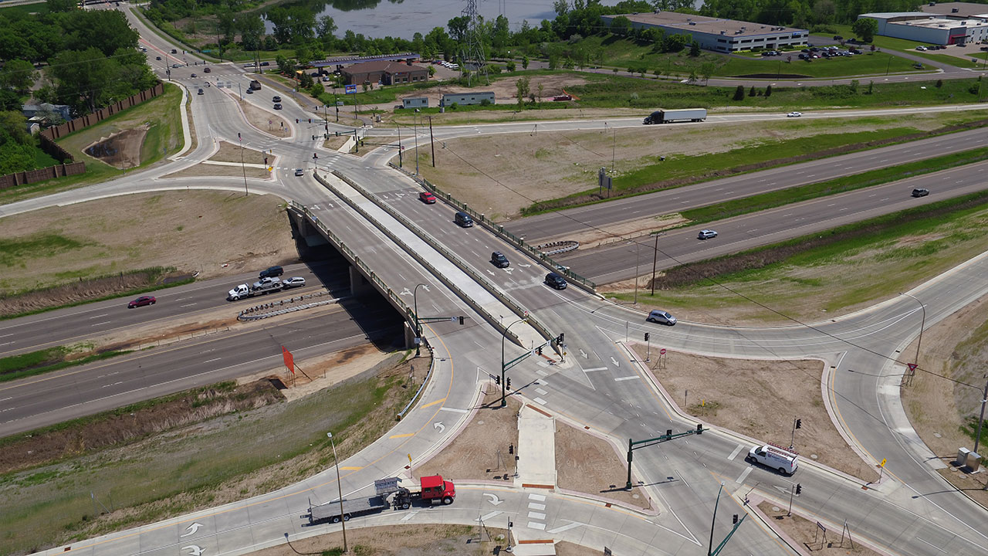
Chapter 10 - Grade Separations and Interchanges
A new section on the diverging diamond interchange (DDI)
( aka double crossover interchanges )

Slide 38
Chapter 10 - Grade Separations and Interchanges
A new table for maximum ramp grade (replacing paragraph text)
Acceleration and deceleration lane length table expanded to include 80 mph [130 km/h] mainline design speed

Slide 39

Green Book, 7th Edition Availability
(from AASHTO Publications) https://store.transportation.org/Catalog/PublicationCatalog/1

Slide 40
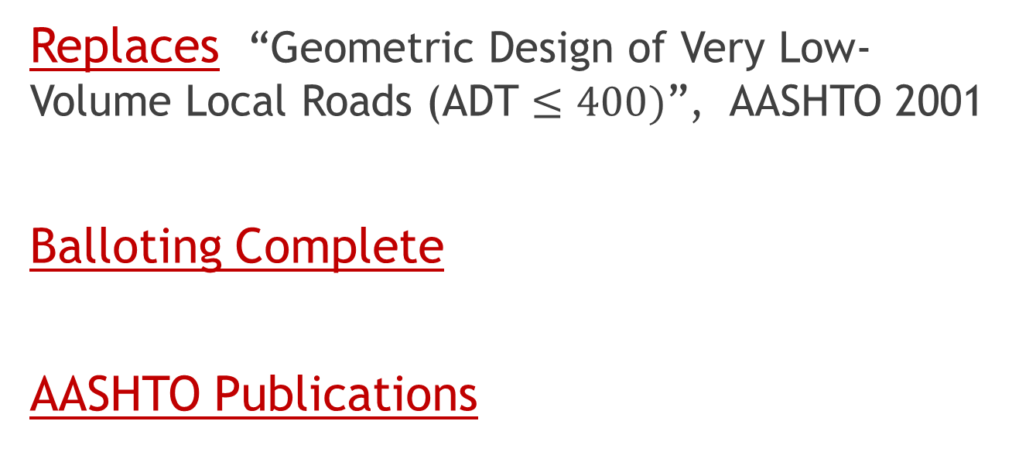
Geometric Design of Low Volume Roads
Replaces “Geometric Design of Very Low-Volume Local Roads (ADT $≤400)$”, AASHTO 2001
Balloting Complete
AASHTO Publications

Slide 41
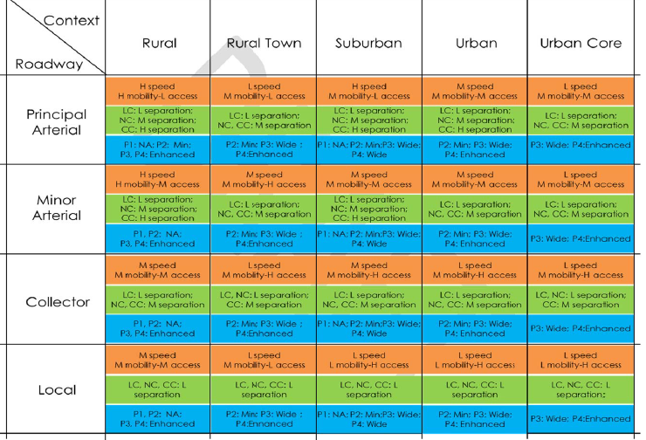
GB8: Vision
Multimodal Matrix ?
NCHRP 855
Speed, Mobility, Accessibility: H, M or L
Bicycle Connectors: LC Local, NC Neighborhood or CC: Citywide
Pedestrian Traffic Levels: P1 rare, P2 low P3 medium P4 High
Pedestrian Traffic Width: Minimum, Wide or Enhanced

Slide 42
GB8 Vision
NCHRP Report 839: A Performance-based Highway Geometric Design Process
Objectives: (1) develop a comprehensive, flexible design process to meet the needs of geometric designers in the future and (2) update AASHTO's Guidelines for Geometric Design of Very Low-Volume Roads.
The design process must consider:
• Context setting of the facility
• Desired performance outcomes for the facility for the various modes
• Methods for evaluating tradeoffs associated with design alternatives
• Flexibility to address issues from stakeholder involvement

Slide 43
Questions… ?
    Jeff Jones, Assistant Chief Engineer
    Tennessee Department of Transportation
    Jeff.C.Jones@tn.gov
    (615) 741-2831

